Slide 1
DBMS PROJECT
Project Name : SAKEC Mobile Service Centre
Members:
HARSH PATEL : 39 SHRUTI PATEL : 40 YASH PATEL : 41 VIKAS PATRA : 42 SIDHHESH PRABHU : 43

Slide 2
SAKEC MOBILE SERVICE CENTRE
PROBLEM STATEMENT:
Construct the user interface and database management system for mobile service centre .If user have technical issues in mobile, in that case user can easily resolve problems, by login into own account or new user can signup into the new account.

Slide 3
ER DIAGRAM
STEP 1 : Identify all entities
Mobile Service Centre
customer
Mobile

Slide 4
STEP 2 : Identify all attributes
msc_name
msc_Id
msc_Address
username
password
F.N
L.N
mobile_no
mobiledevice

Slide 5
STEP 3 : Draw entities
msc_name
(a)
msc_Address
msc
msc_id

Slide 6
(b)
username
L.N
Customer
password
F.N

Slide 7
(c)
mobile_no
mobile
Mobiledevice

Slide 8
STEP 4 : Identify Relationships
1
N
msc
has
customer
1
M
customer
owns
mobile

Slide 9
F.N
username
STEP 5 : ER Diagram
Customer
password
1
1
L.N
registers
owns
msc_name
N
msc
M
msc_Id
msc_add
Mobile
Mobile_no
Mobile_device

Slide 10
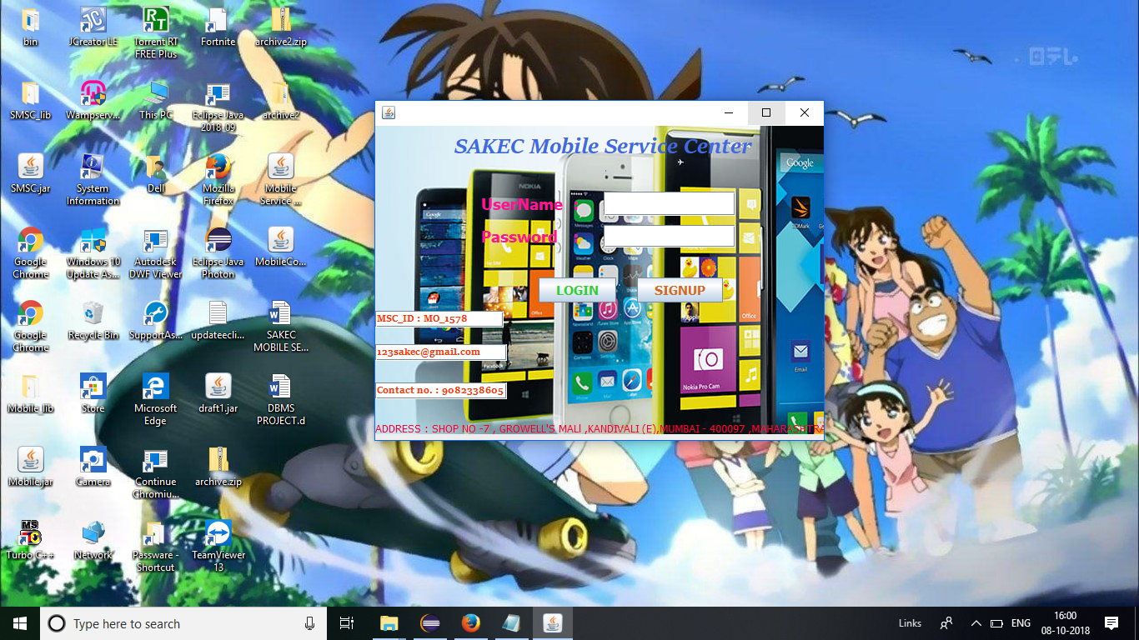
FORM DESIGN
LOGIN FORM

Slide 11
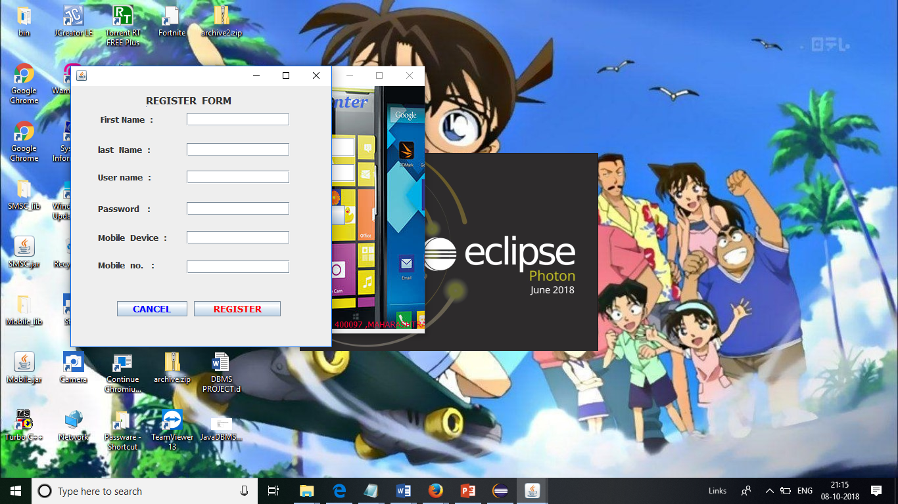
NEW USER SIGNUP PAGE

Slide 12
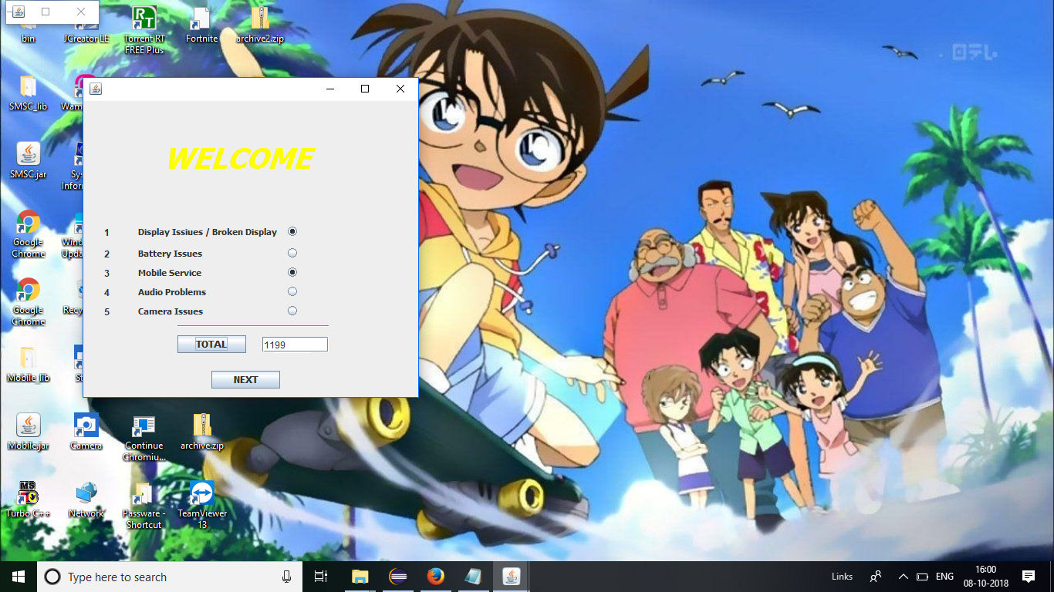
USER MAINPAGE

Slide 13
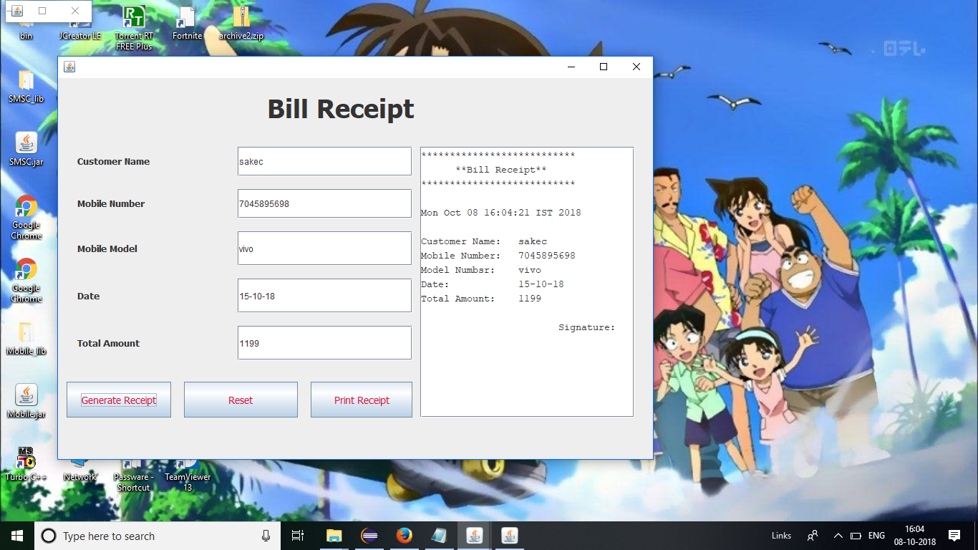
BILL RECEIPT

Slide 14
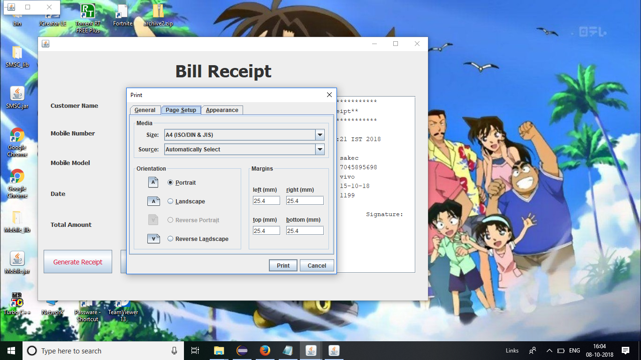
PRINT DETAILS

Slide 15
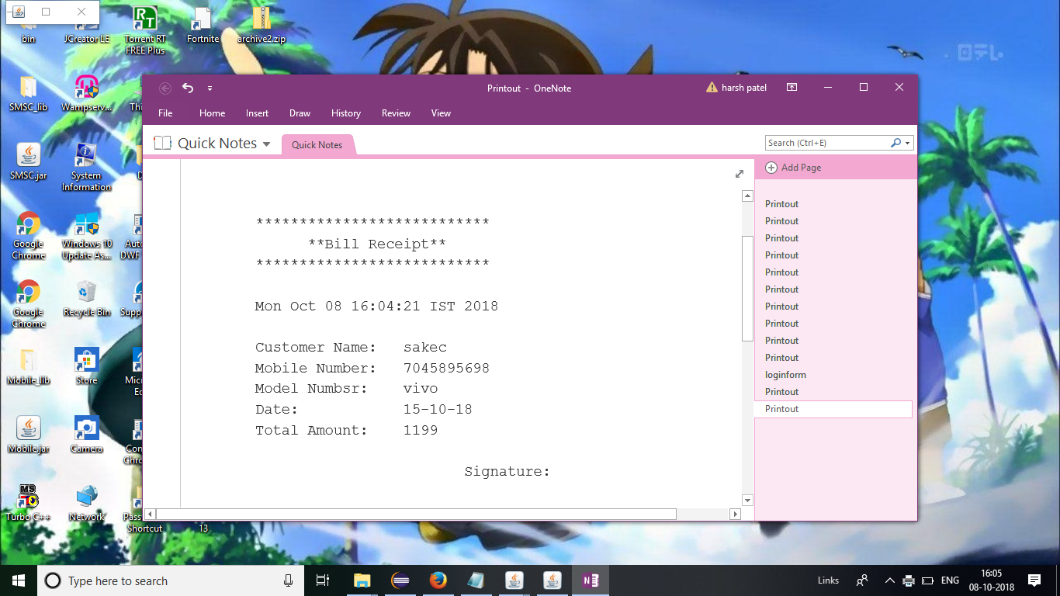
RECIEPT AFTER PRINTING

Slide 16
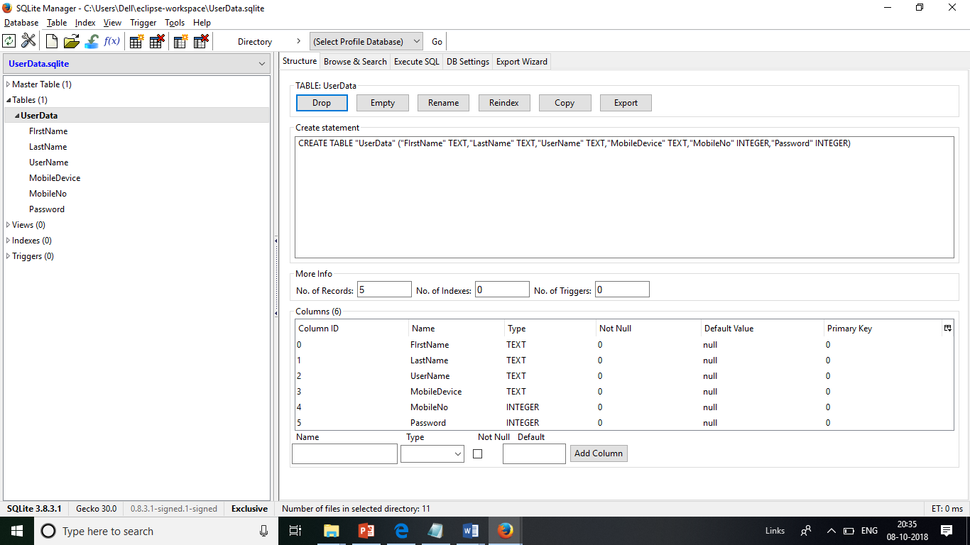
DATABASE IMPLEMENTATION

Slide 17
import java.sql.*; import javax.swing.*; public class sqliteConnection { Connection conn=null; public static Connection dbConnector() { try { Class.forName("org.sqlite.JDBC"); Connection conn=DriverManager.getConnection("jdbc:sqlite:C:\\Users\\Dell\\eclipse-workspace\\UserData.sqlite"); JOptionPane.showMessageDialog(null,"Connection successful"); return conn; } catch(Exception e) { JOptionPane.showMessageDialog(null,e); return null; } } }
DATABASE CONNECTIVITY (SQLITE)

